Slide 1

DIVIDE PAGE INTO
COMPONENTS

Slide 2
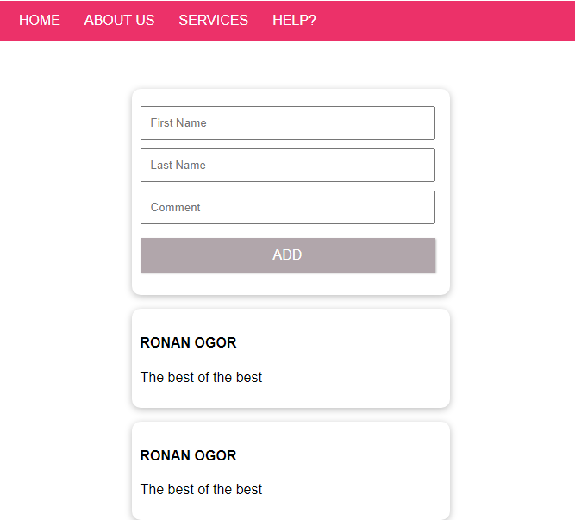
APP
FOR NOW
The application is for now displayed on the VUE APP :

Slide 3
APP
TODO :
You need to divide this app into components
<friend-nav>
Component friend-nav
<friend-form>
Component friend-form
<friend-card>
Component friend-card
<friend-card>

Slide 4
You also need to MOVE each CSS rules to the related components
At then end, the template of the APP.VUE should look like this code :
<template>
<section>
<friend-nav></friend-nav>
<friend-form></friend-form>
<friend-card></friend-card>
<friend-card></friend-card>
</section>

